Slide 1

DIGITAL PORTFOLIO
STUDENT NAME: R.SURIYALAKSHMI
REGISTER NO AND NMID: astvu30430424u18045
DEPARTMENT: B.Sc.computer science
COLLEGE : Arignar Anna govt arts college for women
PROJECT TITLE:
Frontend Development of Digital Clock Project
Notes:
Digital Portfolio
- STUDENT NAME: ____________
- REGISTER NO AND NMID: ____________
- DEPARTMENT: ____________
- COLLEGE / UNIVERSITY: ____________
- PROJECT TITLE: Frontend Development of Digital Clock Project

Slide 2


AGENDA
Problem Statement
Project Overview
End Users
Tools and Technologies
Portfolio Design and Layout
Features and Functionality
Results and Screenshots
Conclusion
GitHub Link

Slide 3

Problem Statement
Traditional wall clocks and static time displays
lack interactivity and modern design.
The problem is to create a dynamic, responsive,
and visually appealing digital clock using frontend
technologies that can run directly on any web browser.

Slide 4

Project overview
The Digital Clock Project demonstrates the use of HTML,
CSS, and JavaScript to display a real-time
clock in HH:MM:SS format.
The project focuses on:
Clean and responsive
design
Real-time time updates
(every second)
Customizable styling
(dark/light themes possible)

Slide 5

Who Are the End Users?
Students learning frontend development concepts
Developers practicing small JavaScript projects
General Users who need a lightweight clock for their desktop, website, or dashboard

Slide 6
Tools and Technologies
HTML5 – Structure of the clock
CSS3 – Styling and layout
JavaScript (ES6) – Real-time functionality
VS Code – Development environment
GitHub – Version control and project hosting

Slide 7
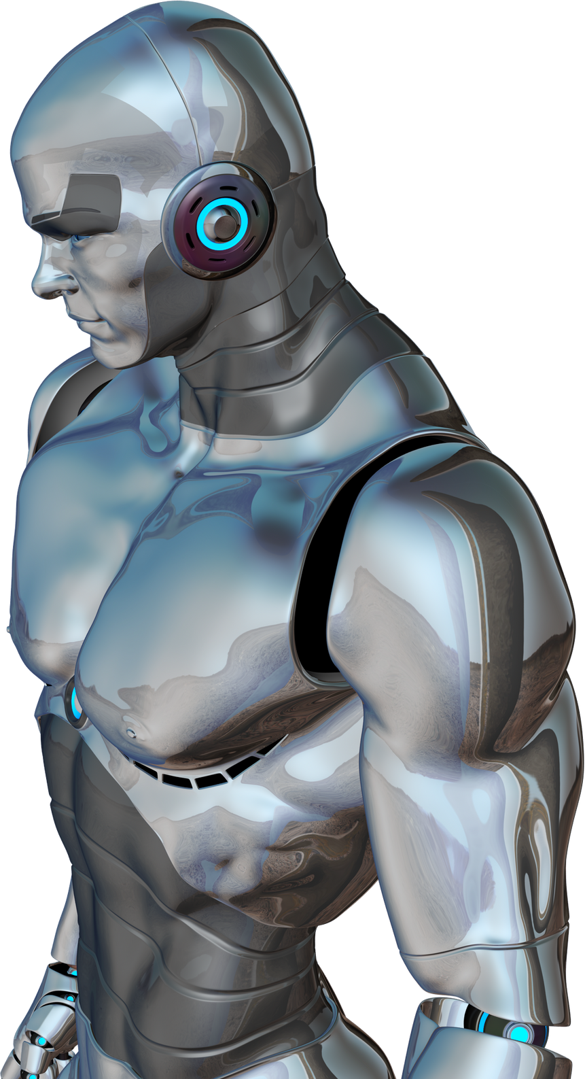
Portfolio Design and Layout
Minimalist design with centered clock display
Responsive layout that adapts to different screen sizes
Custom CSS styling for fonts, colors, and themes
User-friendly UI with simple design approach

Slide 8
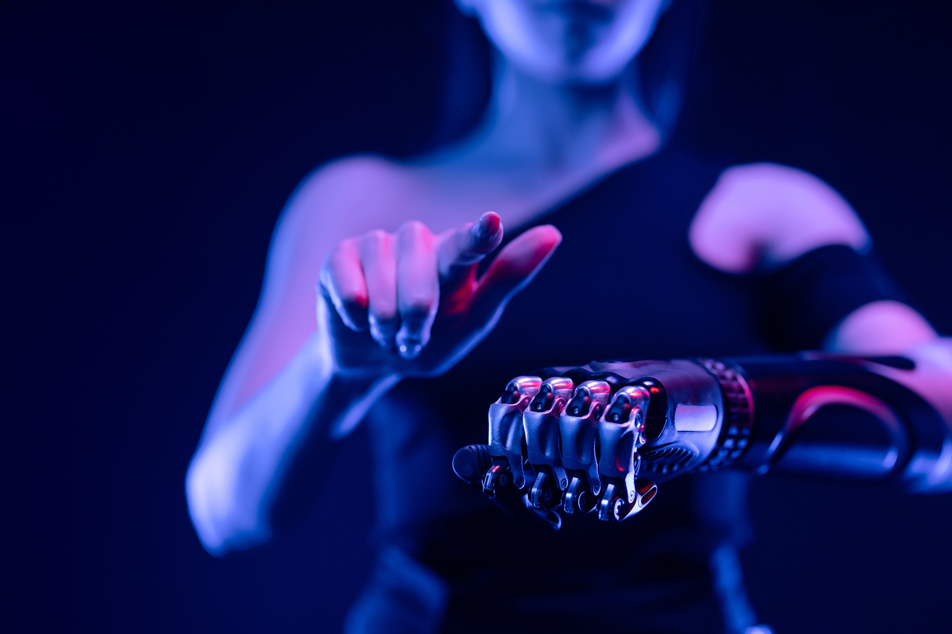
Features and Functionality
Displays real-time digital clock in HH:MM:SS
Automatic updating every second
Responsive design for all devices
Option to add dark/light mode themes
Easy to integrate into other web applications

Slide 9

Results and Screenshots
Output is a working digital clock displayed on a webpage
The clock refreshes in real time without page reload
Provides a modern and professional frontend look

Slide 10
Conclusion
The project successfully shows how frontend technologies
(HTML, CSS, JS) can be combined to build a real-time application.
It helps beginners understand DOM manipulation, styling,
and real-time updates, while being simple enough for practice.

